Slide 1
Predicting U.S. Stock Market Ups and Downs
WANG Ruitao
NI Zhichen
ECON4130 Machine Learning in Economics

Slide 2
Outline
Introduction
Motivation, research background, and literature reviews
Methodology
Research design and descriptive statistics of variables (features & target)
Models chosen
Data analysis
Evaluation and finalized result
Ending
Conclusion, limitations and references

Slide 3
Part I : Introduction

Slide 4
Motivation and Purpose of Study
As students majoring in Econ & CS who have keen interest in Banking & Finance industry, we are curious about the financial market. However, there are numerous models and setups that we can choose to investigate this topic, but which is the best model?
We wish to predict the stock market index through a wide variety of machine learning classification models, in addition to a recurrent neural networks (RNNs) model, to compare and evaluate their performance to seek the best one.

Slide 5
Research Question
Does LSTM, as a Recurrent Neural Network model that has complex structure in nature, will outperform classical classification techniques in predicting stock market movements?

Slide 6
Literature reviews
Schumaker and Chen (2010): SVM is a machine learning algorithm that can classify a future stock price direction Basak and other scholars (Basak et al, 2019) used random forest and Gradient boosted decision trees, reported over 98% accuracies for predicting up and down movements for a variety of companies in U.S. stock market.
Das and Padhy (2012) used backpropagation (BP) and SVM to predict future prices in the Indian stock market. The performance of these techniques are compared and it is observed that SVM provides better results when compared with the results from the BP technique.
The study by Patel, Shah, Thakkar and Kotecha (2015) compares four Indian stock market prediction models from 2003-2012, including ANN, SVM, random forest, and naive-Bayes, which finds that random forest outperforms the other three prediction models.
Huang, Yeh and Lee (2011) address problems that arise when using support vector regression to forecast stock market values when dealing with kernel function hyperparameters.
Basak (Basak et al, 2019) and Jiao (Jiao, 2017) also have used random forest and Gradient boosted decision trees, reported a high accuracies for predicting up and down movements for a variety of companies in U.S. stock market.

Slide 7
Literature Review
Evidence before this study
Added value of this study
This is the first study comprehensively compared the results of different classification models, compared to an additional RNN model, to make predictions of up and down movements of S&P 500 stock market index
Scholars tends to focus on one or a few models to evaluate the performance, lack of a comprehensive perspective to compared between models and figure out the best

Slide 8
Part II : Research Design & Methodology

Slide 9
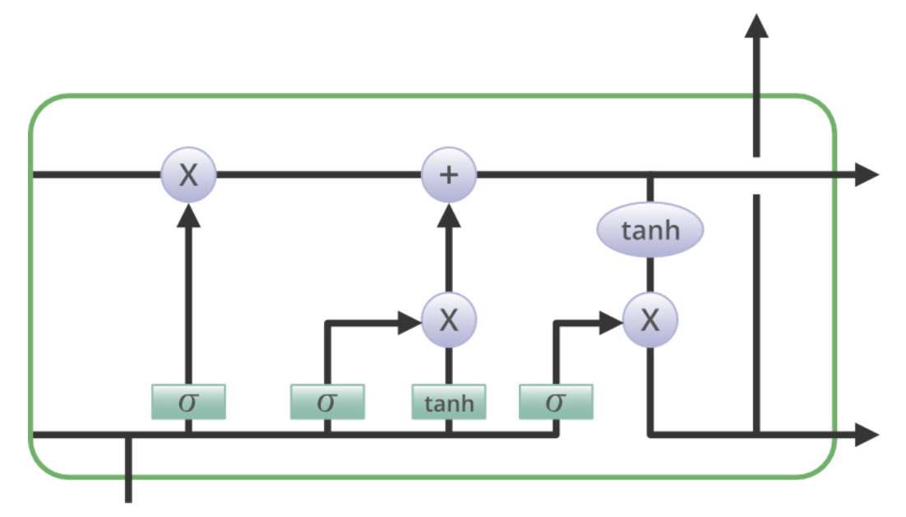
Hypothesis
Given that the LSTM a time-series neural network that is designed to becomplicated in nature, with four layers that interact with one another in a way to produce the output of that cell along with the cell state, we believe it will be better in capturing the complex stock trends and forecasting future movement
Therefore, we assume that the result of LSTM model will outperform all other classical classification models

Slide 10
Research Design – Target Variables
The data chosen is the daily opening price of S&P 500, one of the most common indicator can reflect the overall performance of the U.S. stock market
Stock market has long been characterized by its dynamic, complicated, and non-stationary nature (Fama, 1965)
Therefore, we wish to predict ups and downs rather than specific price, which is proved to have better accuracies when making predictions (Thawornwong & Enke, 2004), in order to maximized the performances
We calculate daily changes in prices, and convert into binary variables (1 for up/positive, 0 for down/negative)

Slide 11
Research Design – Feature Variables
Since the frequency for the target variable is daily, we wish to only select daily data to match the consistency of frequency
We did not include any technical indicator (such as MACD, RSI), as referred to Qian and Rasheed (2007) paper that stock prices driven by technical indicator move slowly in response to the news. Chavan and Patil also investigated the effect of technical indicator in their paper (2013), concluded that it is useful in predicting individual stocks but not funds/market index.
In addition, investors’ sentiment always plays a significant role in the stock market (Lakshmi et al. 2017). So, we have choose CBOE Volatility Index (VIX index), a common sentiment indicator that used to captures market sentiments (Campisi et al., 2024)

Slide 12
Research Design – Feature Variables
Variable type | Characteristics | Name | Source | Additional data preprocessing
Target | Stock Market Index | S&P 500 | Yahoo Finance | Interpolated for missing values and take difference between daily prices, convert into a binary variable (1 for up and 0 for down)
Features | Sentiment Indicator | CBOE Volatility Index (VIX index) | Yahoo Finance
Features | Macroeconomic Indicator | Gold price | Yahoo Finance
Features | Macroeconomic Indicator | Oil Price | Yahoo Finance
Features | Macroeconomic Indicator | ICE U.S. Dollar Index (exchange rate index) | Yahoo Finance
Features | Macroeconomic Indicator | Effective Federal Fund rate | Federal Reserve Bank of New York

Slide 13
Research Design – Time Horizon
Time period: March 1st 2016 – Oct 25th 2024
Data are interpolated to fill out missing dates (weekends and holidays)
3161 observations * (1 target + 5 features) = 18966 datasets in total
Reason for selecting this time period:
Brexit was announced on 31st January. Breinlich’s research “The Economic Effects of Brexit – Evidence From the Stock Market” (Breinlich et al., 2018) shown that this has a significant impact on the stock market. This external volatility makes it challenging for the model to accurately predict the potential influences. Therefore, we wish to start the data somehow after this event to prevent the influence of Brexit. Coincidently, the Effective Fedearal Reserve Rate posted by Federal Reserve Bank of New York started from March 1st of 2016, so we choose this as the starting point of datasets.

Slide 14
General Work Flow
Data Scraping
Feature Engineering
Performing Walk-Forward Splits
Cross-Validations and Parameter Tuning
Results and Evaluation

Slide 15
Data Scraping and Preprocessing
Retrieve Multiple Datasets:
Retrived data from S&P 500, Gold, Oil Prices, U.S. Dollar Index, and VIX Index from Yahoo Finance
Retreived data for Effective Federal Funds Rate from the Federal Reserve Bank of New York
All Data Scraping were done by Python
Merge Datasets based on date
Interpolated Missing Data:
Merge all data into one dataframe, applied linear interpolation to fill missing values in the time series.

Slide 16
Feature Engineering: Calculating Trends
Calculated Daily Differences: For each feature (e.g., S&P 500, Gold), computed the daily difference to capture short-term trends.
Binary Conversion: Converted daily differences to binary values:
1 for upward trend
0 for downward trend

Slide 17
Cross-Validation
What is Cross-Validation? A technique to assess model performance by splitting data into multiple training, validation, and test sets. Each dataset will be distinguished (used only once) and no over-lapping
Why Use It? Helps ensure the model generalizes well by reducing overfitting.

Slide 18
Walk-Forward Split (Time Series Validation)
What is Walk-Forward Split?
A special form of cross-validation used for time series data.
When working with time series data we need to ensure the training data comes before the validation and test data, instead of randomly splitting the data.
How it Works:
The dataset is split into two parts: the training set and the test set. The training set is further divided into a sequence of overlapping subsets, each representing a certain time period. The model is trained on the first subset and self-evaluated on the second subset. Then, the model is re-trained on the second subset and evaluated on the third subset, and so on.

Slide 19
Walk-Forward Split (Time Series Validation)
Why Use Walk-Forward Split?
Prevents data leakage: Test data never leaks into the training phase.
Mimics real-world scenarios where future data isn't available during training.

Slide 20
What split to set?
We refers to Shad’s research (Shad, 2018), who conducted a comparative study of LSTM and DNN to use 25 years of daily stock price to predict daily ups and downs for the stock market, concludes that using 80:10:10 in training validation and testing dataset is the optimal split for cross validation
In his research, he set the window size as 50 for the walk-forward split, with total 15 years of daily datasets. Since we have about 9 years of dataset, to ensure the accuracy while pursue the efficiency, we set the window size as a 30-days walk-forward split (i.e., train the model on days 1-30, evaluate on days 31-60, then train on days 1-60 and evaluate on days 61-90, and so on).

Slide 21
Hyperparameter Tuning
What is Hyperparameter Tuning? The process of selecting the best parameters (e.g., the parameter ‘C’, ‘gamma’, ‘kernel’ for SVM)
How to Tune? Use Grid Search to evaluate each and every combination of parameters with cross-validation
Why Tuning Matters? Optimizes model performance and avoids under/overfitting, without needed of manually looping over the codes

Slide 22
Research Design – Models Selected
Statistical Model
Logit regression
Machine Learning Classification Algorithm
Naive Bayes
Linear Discriminant Analysis (LDA)
Support Vector Machines (SVM)
Decision Tree
K-Nearest Neighbor (KNN)
Recurrent Neural Network model
Long Short-Term Memory (LSTM)

Slide 23
Simple OLS
Using OLS as benchmark is crucial, and very common in other papers
However, not applicable in our investigation - all variables are categorical
OLS result (coefficients) are meaningless

Slide 24
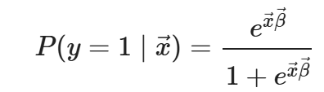
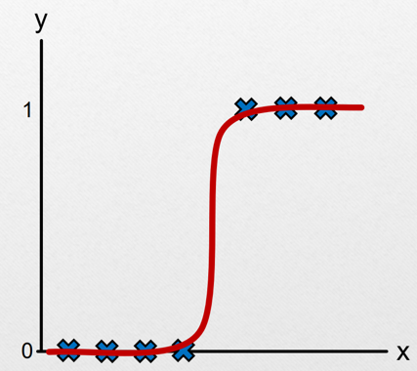
Logit regression
Logistic regression is a supervised machine learning algorithm used for classification tasks where the goal is to predict the probability that an instance belongs to a given class or not.
Logistic regression is used for binary classification where we use sigmoid function, that takes input as independent variables and produces a probability value between 0 and 1.
For example, we have two classes Class 0 and Class 1 if the value of the logistic function for an input is greater than 0.5 (threshold value) then it belongs to Class 1 otherwise it belongs to Class 0. It’s referred to as regression because it is the extension of linear regression but is mainly used for classification problems.

Slide 25
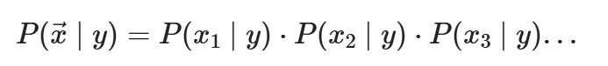
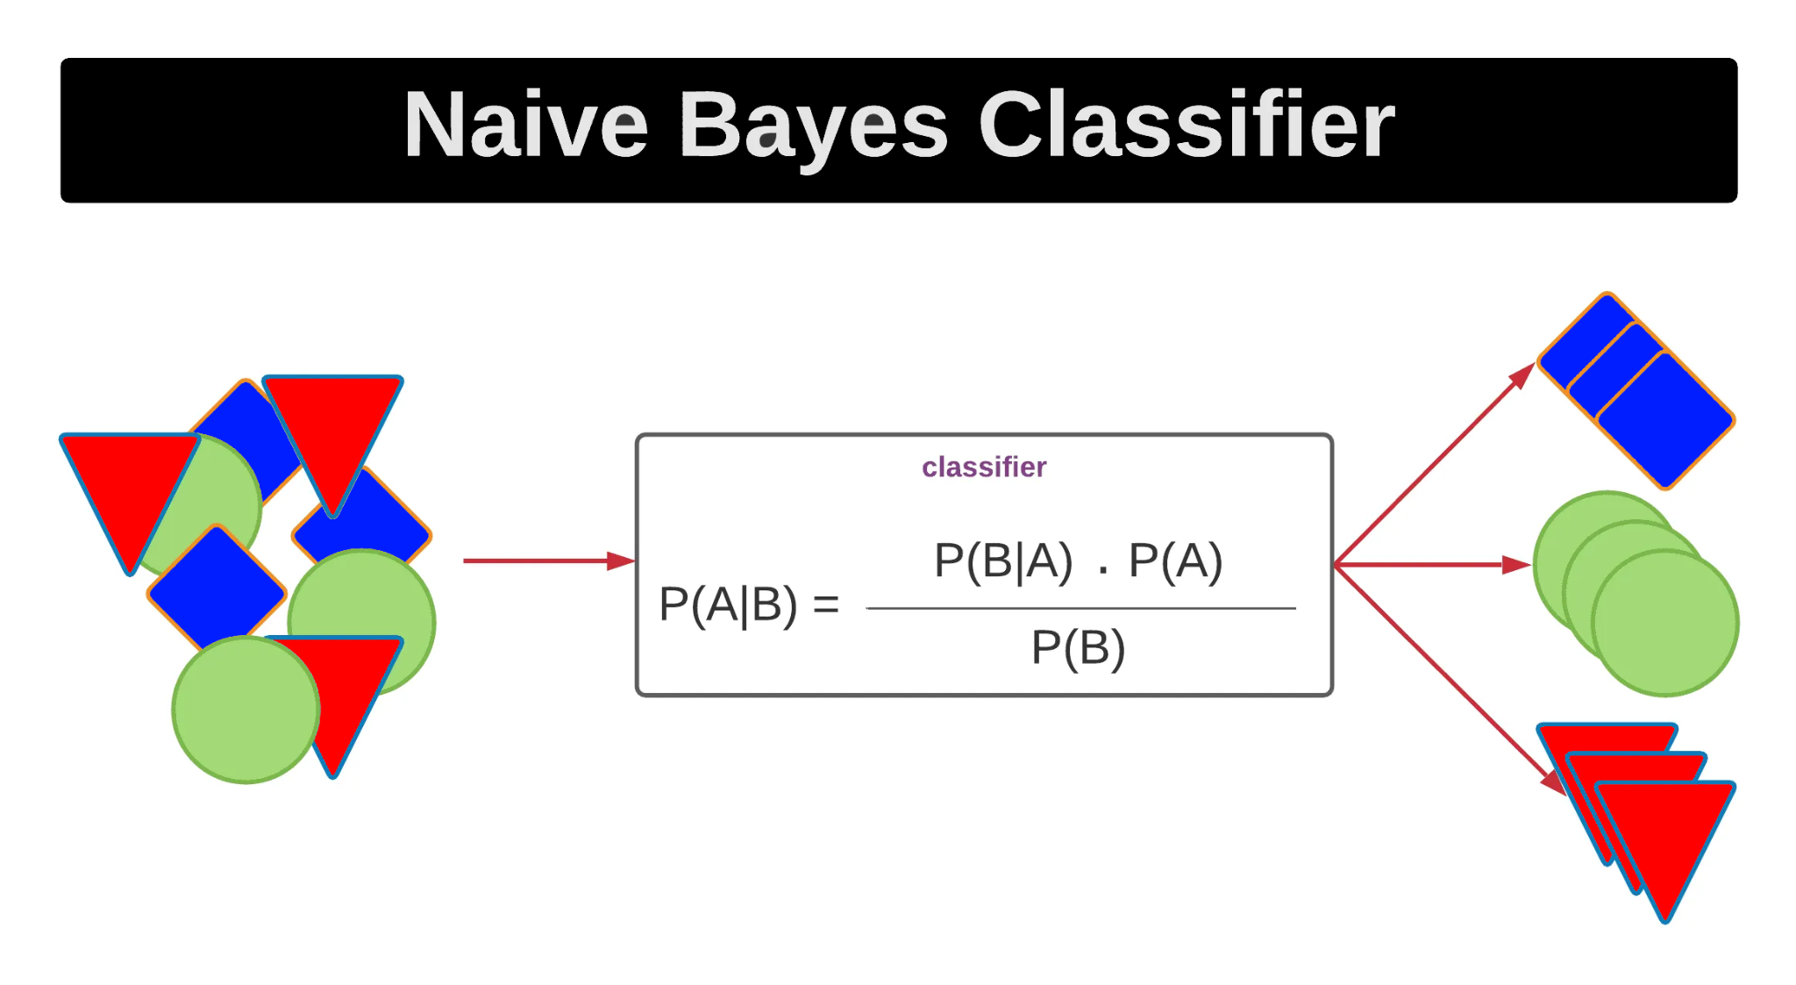
Bayes Rule: Naïve Bayes
A family of algorithms based on Bayes' Theorem, widely used for their simplicity and efficiency in machine learning, assuming:
Feature independence: The features of the data are conditionally independent of each other, given the class label.
Continuous features are normally distributed: If a feature is continuous, then it is assumed to be normally distributed within each class.
Discrete features have multinomial distributions: If a feature is discrete, then it is assumed to have a multinomial distribution within each class.
Features are equally important: All features are assumed to contribute equally to the prediction of the class label.
No missing data: The data should not contain any missing values.

Slide 26
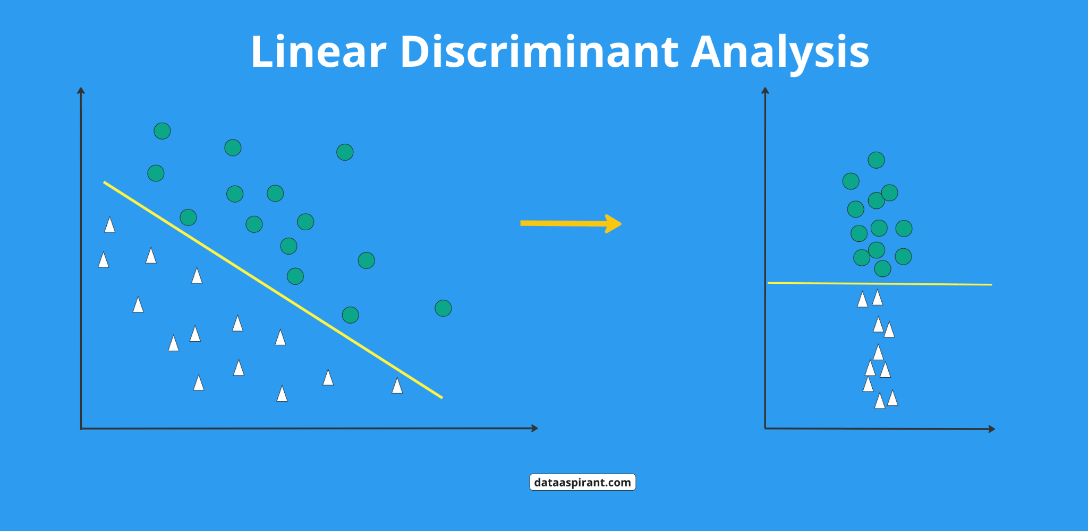
Linear Discriminant Analysis (LDA)
A dimensionality reduction technique primarily utilized in supervised classification problems. It facilitates the modeling of distinctions between groups, effectively separating two or more classes.
LDA assumes that the data has a Gaussian distribution and that the covariance matrices of the different classes are equal.
It also assumes that the data is linearly separable, meaning that a linear decision boundary can accurately classify the different classes.

Slide 27
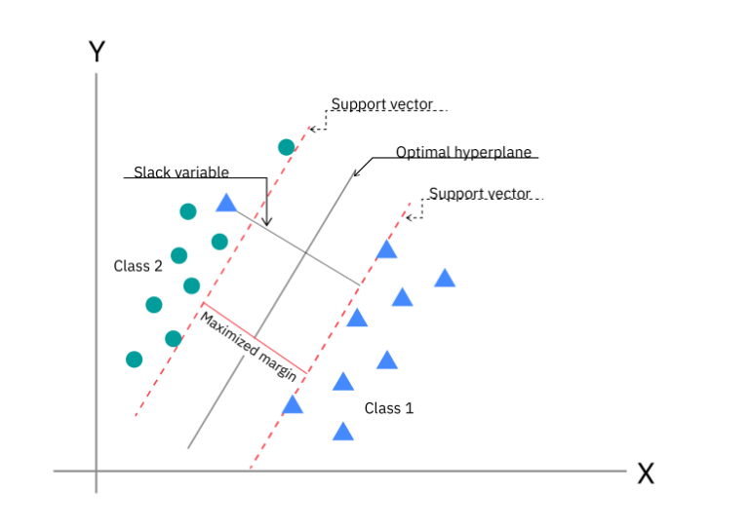
Support Vector Machine (SVM)
The primary objective of the SVM algorithm is to identify the optimal hyperplane in an N-dimensional space that can effectively separate data points into different classes in the feature space. The algorithm ensures that the margin between the closest points of different classes, known as support vectors, is maximized.

Slide 28
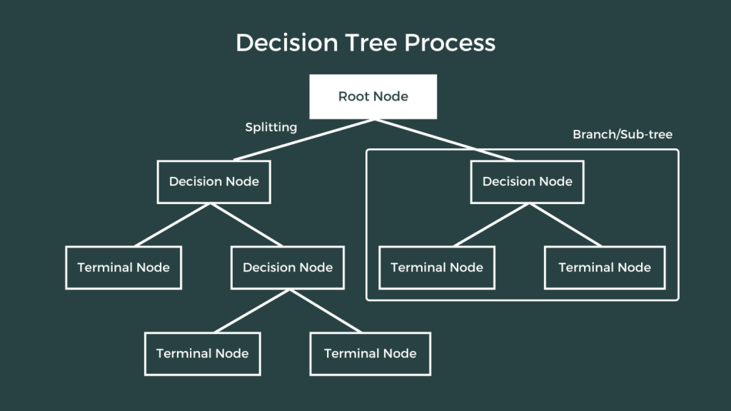
Decision Tree
A decision tree is a flowchart-like structure used to make decisions or predictions. It consists of nodes representing decisions or tests on attributes, branches representing the outcome of these decisions, and leaf nodes representing final outcomes or predictions. Each internal node corresponds to a test on an attribute, each branch corresponds to the result of the test, and each leaf node corresponds to a class label or a continuous value.

Slide 29
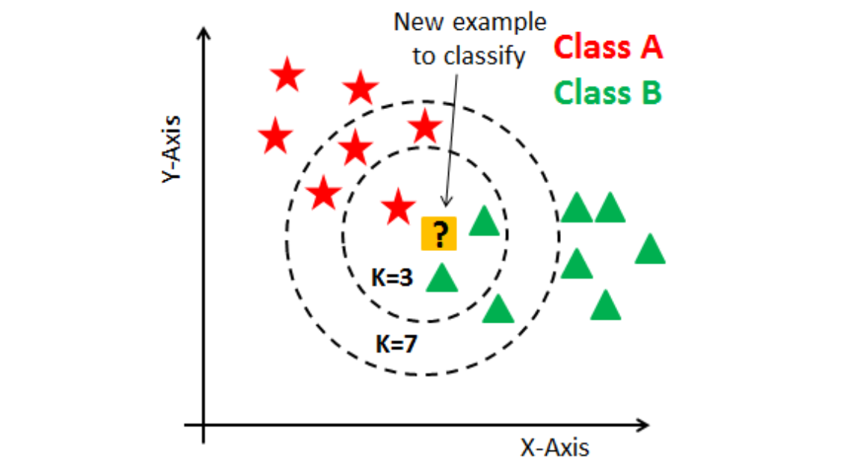
K-Nearest Neighbors
K-Nearest Neighbors (KNN) is one of the most basic yet essential classification algorithms in machine learning. It belongs to the supervised learning domain and finds intense application in pattern recognition, data mining, and intrusion detection.
It is widely disposable in real-life scenarios since it is non-parametric, meaning it does not make any underlying assumptions about the distribution of data (as opposed to other algorithms such as GMM, which assume a Gaussian distribution of the given data). We are given some prior data (also called training data), which classifies coordinates into groups identified by an attribute.

Slide 30
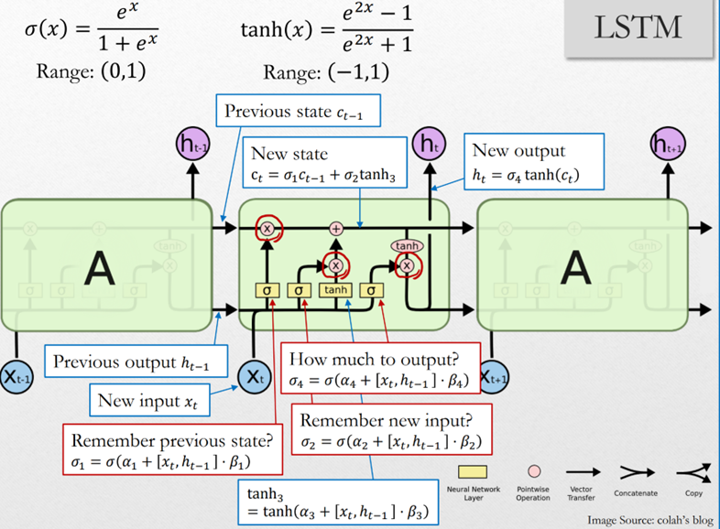
LSTM
LSTM networks are an extension of recurrent neural networks (RNNs) mainly introduced to handle situations where RNNs fail, especially in time series forecasting
It fails to store information for a longer period of time. At times, a reference to certain information stored quite a long time ago is required to predict the current output. But RNNs are absolutely incapable of handling such “long-term dependencies”.
There is no finer control over which part of the context needs to be carried forward and how much of the past needs to be ‘forgotten’.
Other issues with RNNs are exploding and vanishing gradients (explained later) which occur during the training process of a network through backtracking.

Slide 31
Part III: Data Analysis

Slide 32
Procedure of work flow
Download data from websites through data scraping techniques and merged into one dataframe
Data Preprocessing
calculate daily difference in price
based on the result, convert into binary variables (1 for up, 0 for down)
Model Testing
Conduct Walk Forward Split and fine-tuned for hyperparameters
Run the model, cross-validation to seek best parameters
Evaluation
Validation datasets and testing datasets are set both 10%
perform classification report and Area Under Curve (AUC)

Slide 33
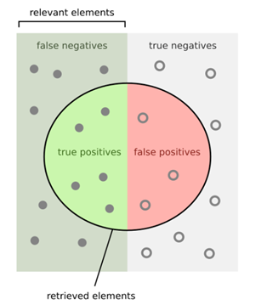
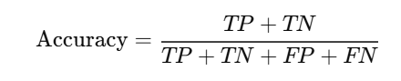
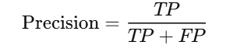
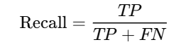
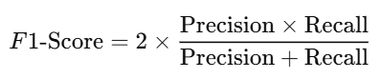
Model Evaluation Metrics
Confusion Matrix: A matrix showing the counts of actual vs predicted values for each class. Key metrics derived: True Positive (TP), False Positive (FP), True Negative (TN), False Negative (FN).

Slide 34
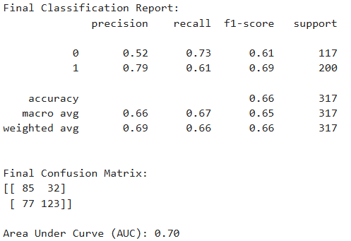
Result: Logistic Regression
Parameters:
'c': 0.75
'solver': 'liblinear'

Slide 35
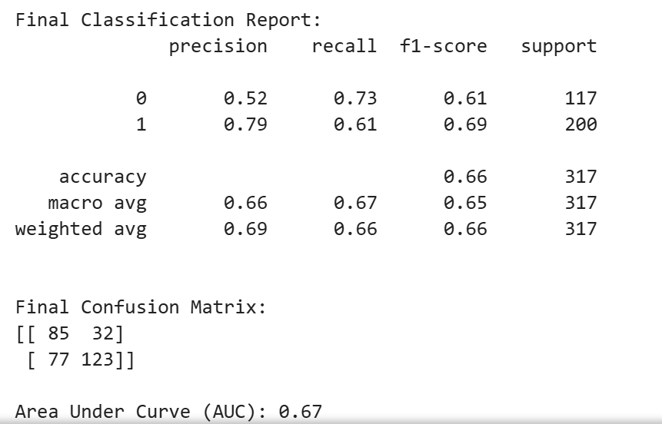
Result: SVM
Parameters:
'C': 0.05,
'gamma': 'scale',
'kernel': 'poly'

Slide 36
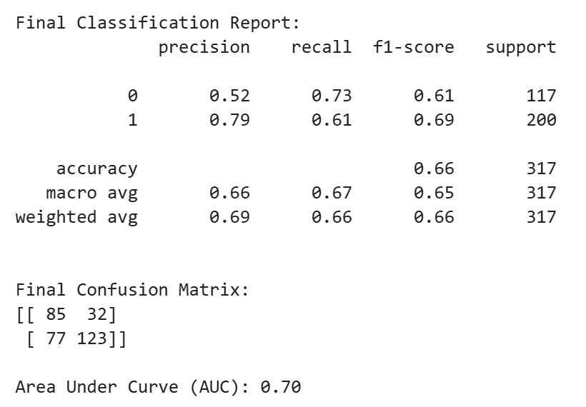
Result: LDA
Parameters:
'shrinkage': 'auto',
'solver': 'eigen'

Slide 37
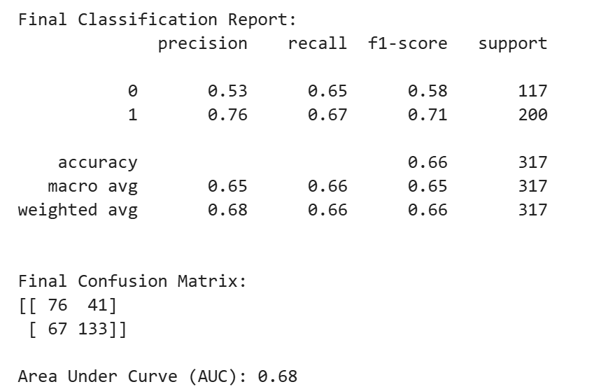
Result: K-Nearest Neighbors
Parameters:
'algorithm': 'brute',
'leaf_size': 3,
'metric': 'minkowski',
'n_neighbors': 7,
'p': 1,
'weights': 'uniform'

Slide 38
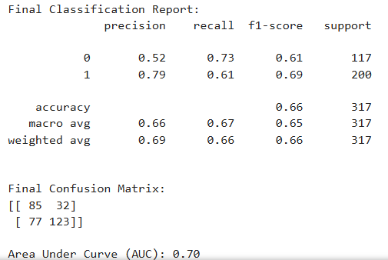
Result: Naive Bayes
Parameters:
'Priors': None
'Var Smoothing': 1e-09

Slide 39
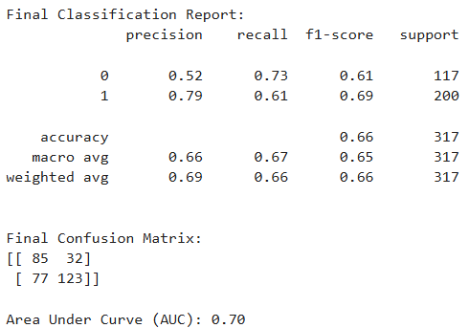
Result: Decision Tree
Parameters:
'max_depth': 3
'min_samples_leaf': 1
'min_samples_split': 10

Slide 40
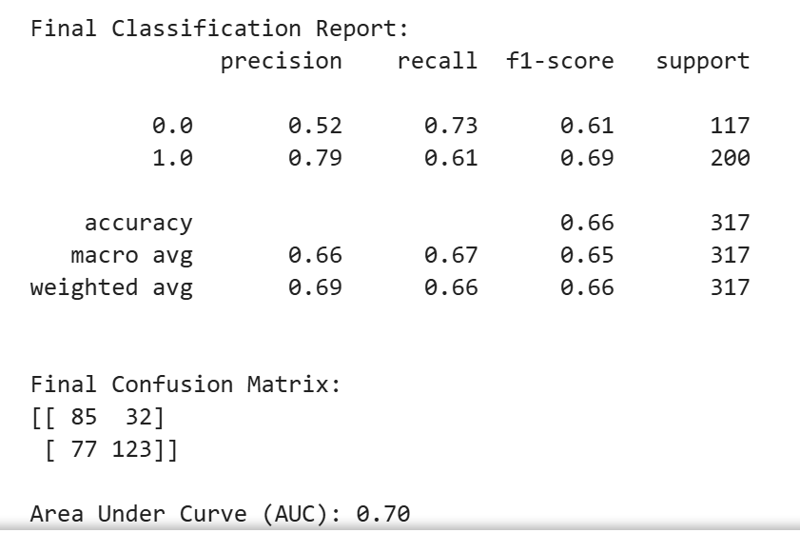
Result: LSTM
Parameters:
'activation': relu,
'batch_size': 4,
'dropout_rate': 0.1,
'hidden_dim':128
'learning_rate': 1*10^-5,
'optimizer': rmsprop,
'regularizer_strength': 0.01

Slide 41
Interpretation of the Result
Models | Accuracy | F1 Score | AUC
Logit Regression | 0.66 | 0.66 | 0.70
Naive Bayes | 0.66 | 0.66 | 0.70
LDA | 0.66 | 0.65 | 0.70
SVM | 0.66 | 0.65 | 0.67
Decision Tree | 0.66 | 0.66 | 0.70
K-Nearest Neighbors | 0.66 | 0.64 | 0.68
LSTM | 0.66 | 0.65 | 0.70

Slide 42
Reflecting on the Hypothesis
Based on our initial hypothesis at beginning, surprisingly, all models have shown an extremely close performances in predicting ups and downs of stock market. This is not aligned with our expectation that LSTM will outperform other models.
Is it coincidence?
Ou and Wang’s research (2009) have used 10 classification techqiques to captures daily Hang Sang Index return movement, and the results of accuracy ranged from 79.60%-86.40%.
Qian & Rasheed (2007) also used 3 classification techniques to predict daily returns of Dow Jones Industrial Average (DJIA) index, and the accuracy of prediction fluctuated within 2% across different models.

Slide 43
Reflecting on the Hypothesis
Given that we conducted a very straightforward feature engineering approach to deal with all variables, we believe that this is the reason for having such phenomenon, where:
All methods that we use in this investigation, not only LSTM but also the classifications methods, are already complex enough to captures the trends of the simply ups and downs of index. So it is difficult for any of model to “outperform” in making predictions compared to others.
We may need more complex feature engineering to differentiate the results across models.

Slide 44
Conclusion & Inspiration
Based on our result so far, we have concluded that:
In terms of making simple predictions, such as ups and downs in daily prices of stock market index, there is no distinguishable difference in performances across classifiers and LSTM model.
Given that this is the case, our investigation indicates that there is no need for using a complex model such as LSTM to make simple predictions, for the sake of efficiency:
For the simple case in our investigation, the LSTM takes approximately 4 hours to run by using a RTX3090 GPU, whereas others take only 20 seconds - 2 minutes for each

Slide 45
Limitations of Study & Future Studies
Relatively small number of observation: around 3200 observations
Trade-off between sample size v.s. data relevance (change in economic conditions, consumer preferences, technology)
Target Variable: We selected S&P 500 as the representative for U.S. market, but we may use other indicators instead (NASDAQ/DJIA)
we can test for return rate, rather directly using the price
we can also use indexes from stock market in other countries as well (e.g., Hang Seng index from Hong Kong, A-Share in China)

Slide 46
Limitations of Study & Future Studies
Types of models: we primary focused on classification approach and only used LSTM as representatives of RNNs approach, we may use other techniques such as clustering techniques, and also other neural network models such as bidirectional RNN, or using N-Beats in the future.
Complexity model: according to studies (Jigar et al, 2015), using a two-stage hybrid model (e.g., two stage fusion approach involving Support Vector Regression in the first stage and Artificial Neural Network) can perform better than that of the single stage prediction models.

Slide 47
References
Basak, S., Kar, S., Saha, S., Khaidem, L., & Dey, S. R. (2019). Predicting the direction of stock market prices using tree-based classifiers. The North American Journal of Economics and Finance, 47, 552-567.
Bhandari, H. N., Rimal, B., Pokhrel, N. R., Rimal, R., Dahal, K. R., & Khatri, R. K. (2022). Predicting stock market index using LSTM. Machine Learning with Applications, 9, 100320.
Breinlich, H., Leromain, E., Novy, D., Sampson, T., & Usman, A. (2018). The Economic Effects of Brexit – Evidence from the Stock Market. Centre for Economic Performance. https://cep.lse.ac.uk/pubs/download/dp1570.pdf
Bu, Q., & Forrest, J. (2021). Comparing sentiment measures in mutual fund performance. International Journal of Managerial Finance, 17(3), 478-493.
Campisi, G., Muzzioli, S., & De Baets, B. (2024). A comparison of machine learning methods for predicting the direction of the us stock market on the basis of volatility indices. International Journal of Forecasting, 40(3), 869-880.
Chavan, P. S., & Patil, S. T. (2013). Parameters for stock market prediction. International Journal of Computer Technology and Applications, 4(2), 337.
Das, S. P., & Padhy, S. (2012). Support vector machines for prediction of futures prices in Indian stock market. International Journal of Computer Applications, 41(3).
E. F. Fama, “The behavior of stock-market prices,” The journalofBusiness,vol.38,no.1,pp.34–105,1965.
Jiao, Y., & Jakubowicz, J. (2017, December). Predicting stock movement direction with machine learning: An extensive study on S&P 500 stocks. In 2017 IEEE International Conference on Big Data (Big Data) (pp. 4705-4713). IEEE.

Slide 48
References
Khan, W., Malik, U., Ghazanfar, M.A. et al. (2020). Predicting stock market trends using machine learning algorithms via public sentiment and political situation analysis. Soft Comput 24, 11019–11043
Lakshmi, V., Harika, K., Bavishya, H., & Harsha, C. S. (2017). Sentiment analysis of twitter data. Int Res J Eng Technol, 4(2), 2224-2227.
Maknickienė, N., & Vaškevičiūtė, A. (2017). Comparison of sentiments data extraction and prediction. Innovative Infotechnologies for Science, Business and Education, 1(22), 14-20.
Patel, J., Shah, S., Thakkar, P., & Kotecha, K. (2015). Predicting stock and stock price index movement using trend deterministic data preparation and machine learning techniques. Expert Systems with Applications, 42(1), 259-268.
R. P. Schumaker and H. Chen, "A Discrete Stock Price Prediction Engine Based on Financial News," in Computer, vol. 43, no. 1, pp. 51-56, Jan. 2010, doi: 10.1109/MC.2010.2.
Schumaker, R. P., & Chen, H. (2009). Textual analysis of stock market prediction using breaking financial news: The AZFin text system. ACM Transactions on Information Systems (TOIS), 27(2), 12.
Thawornwong S, Enke D (2004) The adaptive selection of financial and economic variables for use with artificial neural networks. Neurocomputing 56:205–232
Yeh, C. Y., Huang, C. W., & Lee, S. J. (2011). A multiple-kernel support vector regression approach for stock market price forecasting. Expert Systems with Applications, 38(3), 2177-2186.

